Slide 1


Introduction to NMAP
Open Source Port Scanner

Slide 2

Agenda
What is NMAP
Port Scanning
NMAP and Security Reviews
Demo of NMAP
Questions

Slide 3
Objective
Introduce the latest Version of NMAP
Review basic concepts on NMAP
Provide practical examples of using NMAP in the field as part of an audit or Security Review
Introduction to NMAP
3

Slide 4
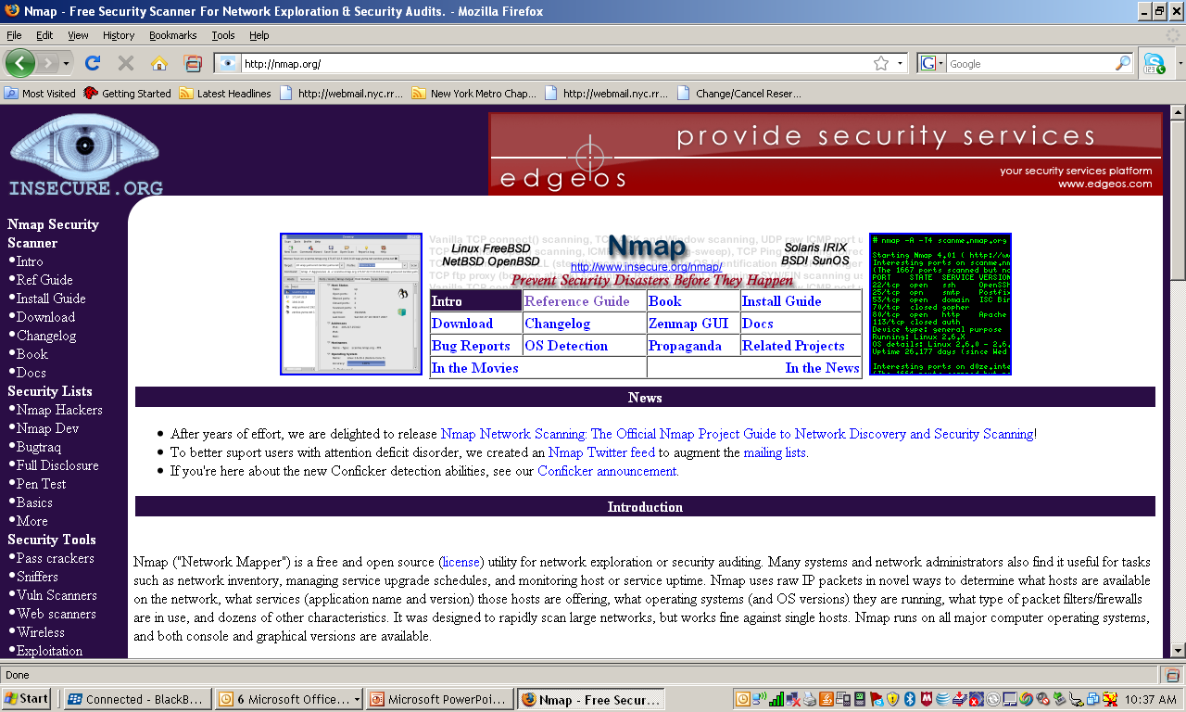
Where to get NMAP
http://nmap.org/
Introduction to NMAP
4

Slide 5
NMAP
One of the most popular port scanners
Started by Gordon Lyon (Fyodor) back in 1997, as an article for Phrack Magazine 51
Started as a fairly simple port scanner, and has suffered some pretty serious feature creep since.
Multiplatform (Linux, Windows, BSD, OS X)
Open Source and available from http://nmap.org/
Introduction to NMAP
5

Slide 6
Versions
Command Line Version
Nmap has traditionally been a command-line tool run from a Unix shell or (more recently) Windows command prompt. This allows experts to quickly execute a command that does exactly what they want without having to maneuver through a bunch of configuration panels and scattered option fields
GUI – Windows and Mac Base
The GUI is bases on Zenmap. Zenmap's tab-based interface lets you search and sort results, and also browse them in several ways (host details, raw Nmap output, and ports/hosts). It works on Linux, Windows, Mac OS X, and other platforms .
It’s all a matter of personnel preference
Introduction to NMAP
6

Slide 7
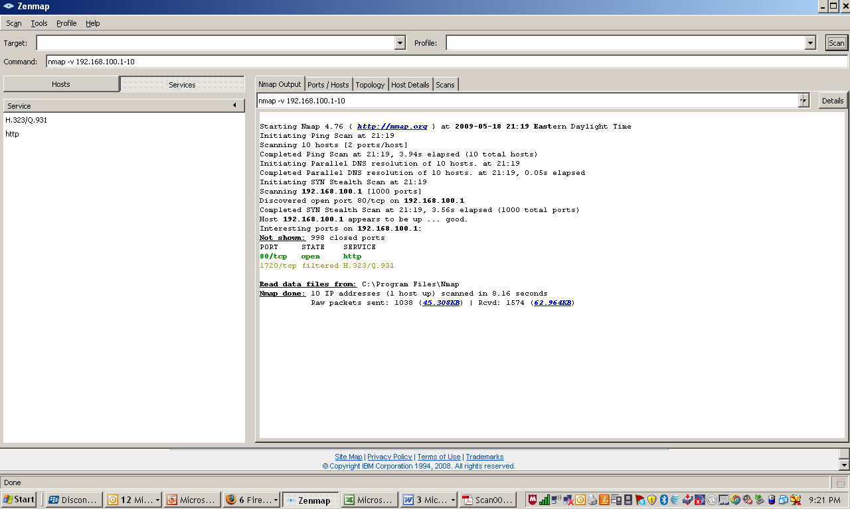
GUI Version
Introduction to NMAP
7

Slide 8
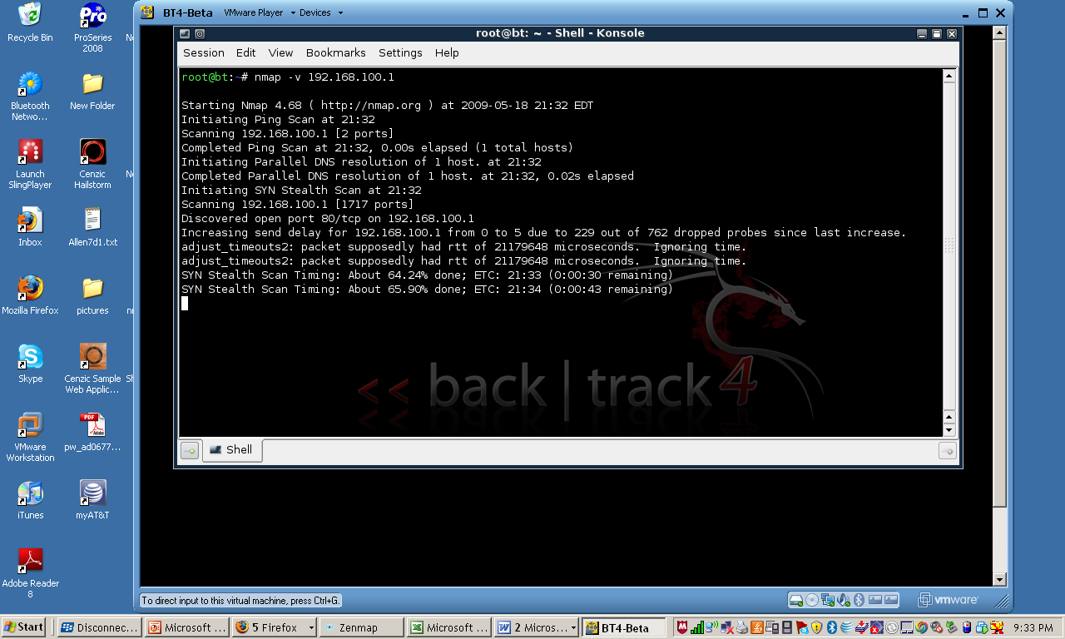
Command Line Version
Introduction to NMAP
8

Slide 9
Can NMAP Crash the Target?
NMAP does not have any features designed to Crash Networks.
NMAP does not try to overwhelm the network. Example
NMAP detects dropped packets and slows down when they occur in order to avoid overloading the network.
Nmap does not send any corrupt packets.
Reports of NMAP crashing systems are rare, but they do happen.
Many of these systems are unstable in the first place. Poorly written applications – TCP/Stacks.
Introduction to NMAP
9

Slide 10
Can NMAP Crash the Target?
If many cases finding a machine that crashes from a certain scan is valuable.
To prevent potential problems
Limit the number of Scans and machines
Use SYN (-sS) scan instead of connect scan (-sT)
Version scanning (-sV) risks crashing poorly written applications
Introduction to NMAP
10

Slide 11
What NMAP CAN DO – Security / Perspective
Port Scanner – Initial Use
Host Discovery
Port Scanning
Remote OS Detection
Detection of Rogue Access Points
Introduction to NMAP
11

Slide 12
Host Discovery
Practical to discover specific nodes:
Auditors may want to find every device on a particular network segment
Network administrators may look for hosts running specific services
Several methods that nmap offers
Ping Scan (-sP) – finds hosts that only respond to Pings responds to simple ICMP Ping requests
List Scan (-sL) – does a reverse DNS Lookup
Just does a simple list
Introduction to NMAP
12

Slide 13
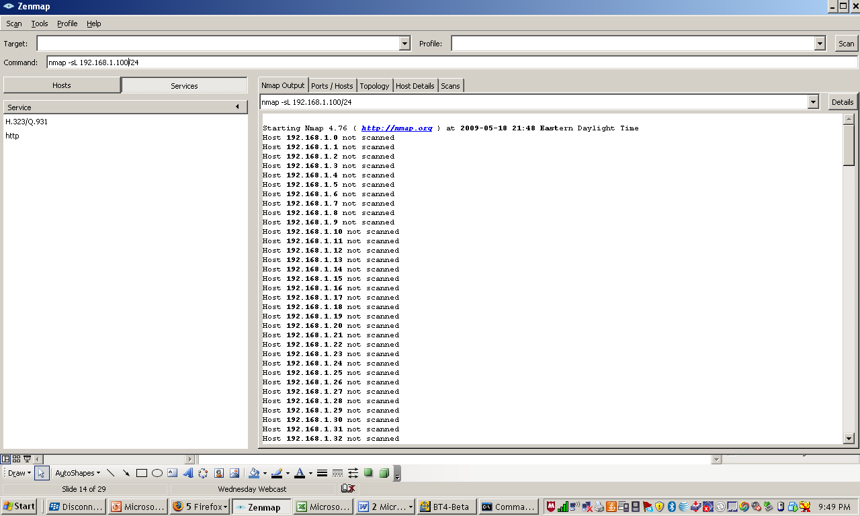
List Scan
Introduction to NMAP
13

Slide 14
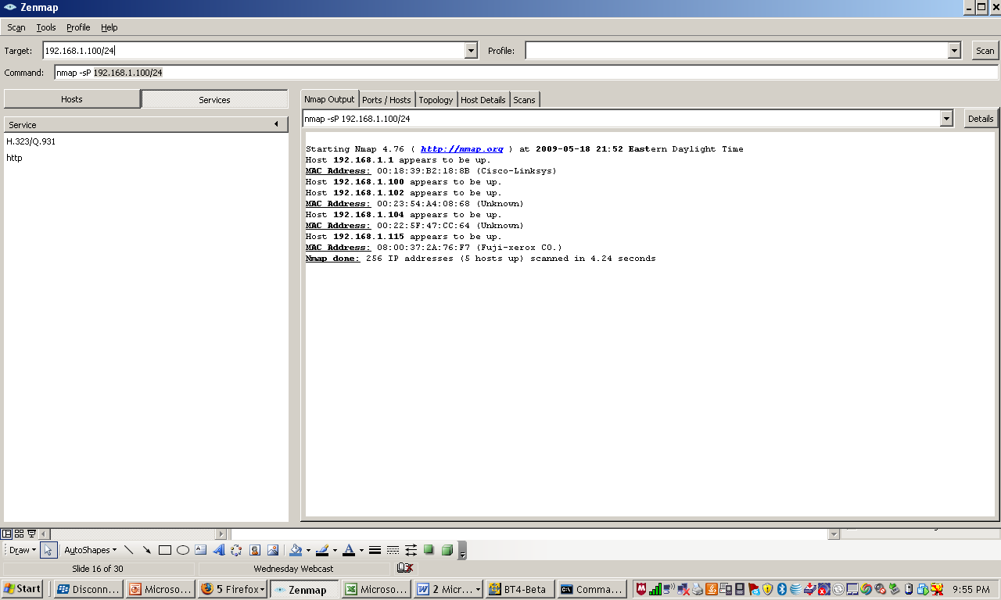
Ping Scan
Introduction to NMAP
14

Slide 15
Port Scanning
What is Port Scanning
Is the act of remotely testing numerous ports to determine what state that they are in.
Why Port Scanning
Audit of Network
Identify potential avenue of Attacks
Identify Services
For Fun and Amusement
Test Intrusion and detection
Introduction to NMAP
15

Slide 16
TCP/IP Basics
To use an analogy, if IPs are an apartment complex’s address, ports are the apartment number
Both UDP and TCP use incoming and outgoing ports
Most IP based services listen on standard ports (HTTP 80tcp, SMTP 25tcp, SMB 139/445tcp, DNS port 53tcp and udp)
Introduction to NMAP
16

Slide 17
What is Port Scanning
Since ports are fairly standard, if port 80 tcp is listening on a host, more than likely it’s running web services
By sending packets to these port numbers, you can see what services are running on the host
Knowing what services are running lets you know something about the potential attack surface
Introduction to NMAP
17

Slide 18
Port States
Open – an application is accepting TCP Connections
Closed – A closed port is accessible, but there is no application listening on it.
Filtered - nmap cannot determine whether the port is open because filtering prevents its probes from reaching the port. This can be the result of firewalls.
Unfiltered – means the port is accessible, but nmap is unable to determine if the port is closed or open
Introduction to NMAP
18

Slide 19
Steps that NMAP takes
Nmap <target>
Converts <target> from a hostname inot an ipv4 address using DNS.
Pings the host
Converts the target IP Address back to the name using reverse DNS query
Launches port scan of 1 – 1024 pus all ports which are registered in nmap-services.
Prints the results
Introduction to NMAP
19

Slide 20
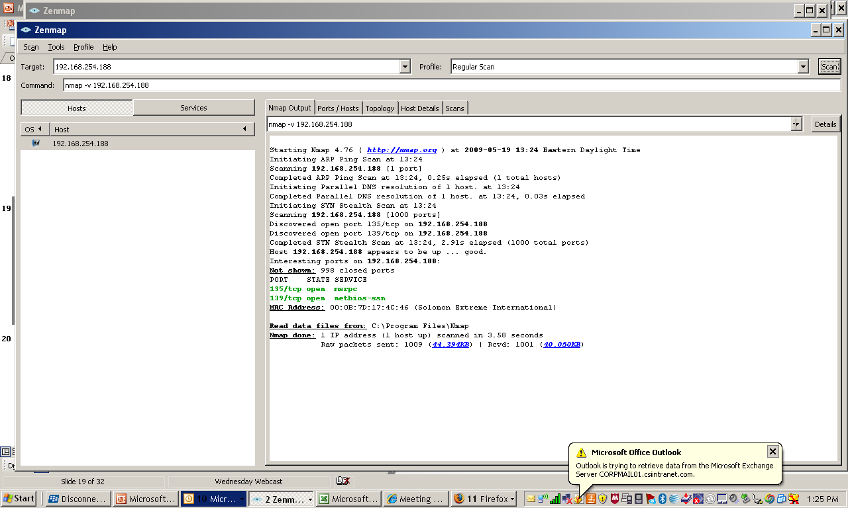
Port Scan
Introduction to NMAP
20

Slide 21
Remote OS Detection
Reasons for discovering underlying OS and Devices
Determine the vulnerability of targeted hosts
Windows NT
Wireless Access points
Tailoring Exploits
Network Inventory and Support
Detecting unauthorized and dangerous Devices
Social Engineering Attacks
Introduction to NMAP
21

Slide 22
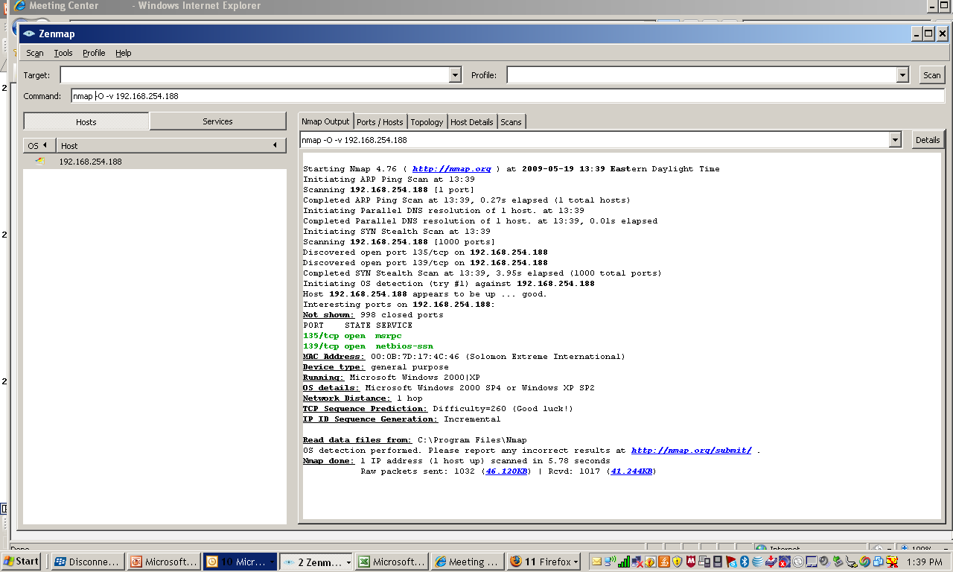
OS Detection
Introduction to NMAP
22

Slide 23
Detection of Rogue Access Points
Problem:
With the use of mobile-devices and cheap commodity networking equipment, companies are increasingly finding that employees are extending their networks in undesirable ways.
Users have been found to install WAP devices in their cubicles so that they can work from the any location.
It’s easier to attack an network from a wireless that trying to gain physical access to the building.
Introduction to NMAP
23

Slide 24
Finding WAP
Two ways to find rogue access points:
Sweep wireless airways with a wireless sniffer such as wireshark, Kismet and/or netstumbler.
Scan the wire side with nmap. ( all WAP must be connected to the physical network)
Each technique can miss certain WAP’s. The best approach is to do both and combine the results
Introduction to NMAP
24

Slide 25
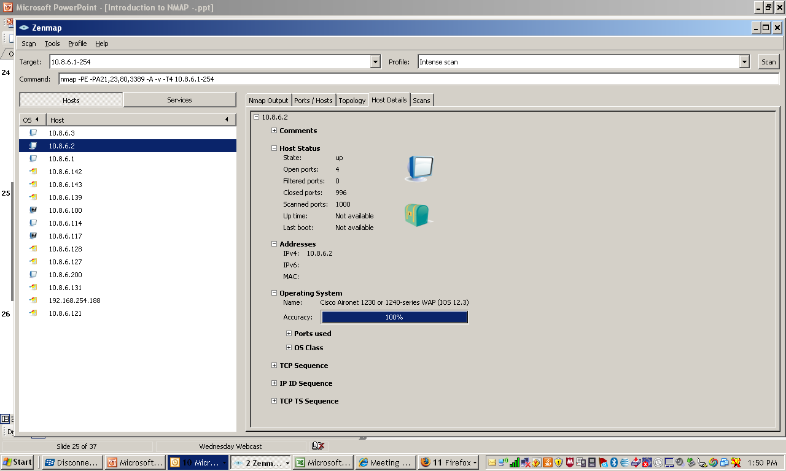
Discovering WAP
Introduction to NMAP
25

Slide 26
Next Steps
Obtain NMAP or ZENMAP
Try it on a local secure network
Perform some simple basic scans until you get familiar with process
Do not try to scan a clients network without their permission
First step in a vulnerability assessment
Introduction to NMAP
26

Slide 27
Questions and Answers
Remember this presentation just touched the very basis of NMAP
Introduction to NMAP
27

Slide 28
Links
Nmap http://nmap.org/
Nmap Videos www.irongeek.com/i.php?page=videos/nmap1 www.irongeek.com/i.php?page=videos/nmap2
Nmap Man Page http://nmap.org/book/man.html
BackTrack Live CD and VM http://www.remote-exploit.org/backtrack.html
Nmap Related Projects http://nmap.org/projects.html
Introduction to NMAP
28

Slide 29
Quiz - 1
NMAP is a
Port Scanner
Vulnerability Scanner
A tool that exploits vulnerabilities
Introduction to NMAP
29

Slide 30
Quiz - 2
NMAP has two versions – Command Line and GUI
True
False
Introduction to NMAP
30

Slide 31
Quiz - 3
NMAP can be use on the following systems except:
Linux
Windows
Mac
UNIX
Introduction to NMAP
31

Slide 32
Quiz - 4
Ports on the system are:
Network Processes
Hardware devices
Places where a ship or boat docks
Introduction to NMAP
32

Slide 33
Quiz - 5
System Crashes can be caused by
Vulnerability Scanner
Port Scanners
Both a and b
Introduction to NMAP
33

Slide 34
Quiz - 6
A host discovery audit test for NMAP could be:
Identify open systems with vulnerabilities
To boldly go were no one has gone before
Look for undocumented WAP
Introduction to NMAP
34

Slide 35
Quiz - 7
Common Process that run on a port include:
Web
Network Backup’s
Telnet
FTP
All of the above
Introduction to NMAP
35

Slide 36
Quiz - 8
The reason for discovering underlying OS and Devices are:
Social Engineering Attacks
Determine the vulnerability of targeted hosts
Network Inventory and Support
All of the above
Introduction to NMAP
36

Slide 37
Quiz - 9
The best way to discover WAP is to:
Scan the local airwaves with a wireless sniffer such as Kismet
Scan the internal wired network looking for rogue WAP
Both 1 and 2
Introduction to NMAP
37

Slide 38
Single Scan
DEMO
Introduction to NMAP
38

Slide 39
OS Detection and Aggressive Scan
DEMO
Introduction to NMAP
39

Slide 40



www.controlsolutions.com

